Slide 1
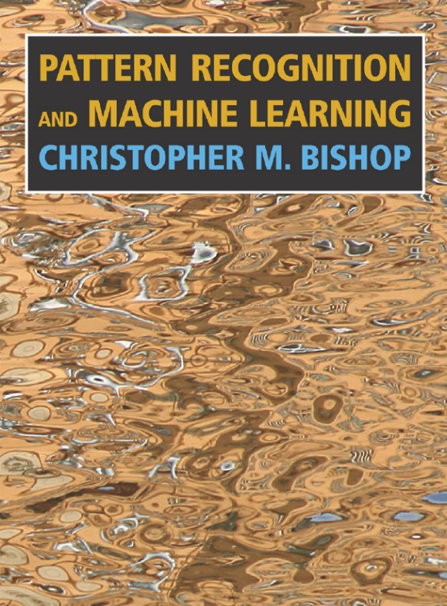
PATTERN RECOGNITION
AND MACHINE LEARNING
CHAPTER 1: INTRODUCTION
Christopher M. Bishop

Slide 2
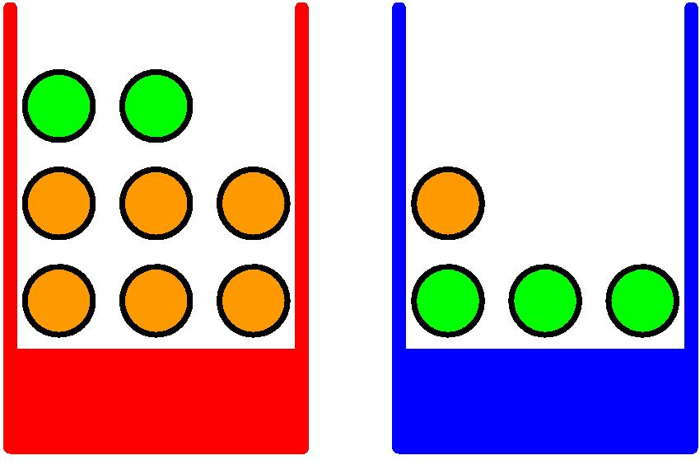
Probability Theory
Apples and Oranges

Slide 3
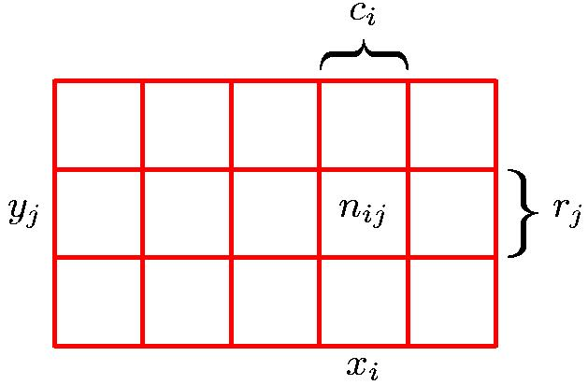
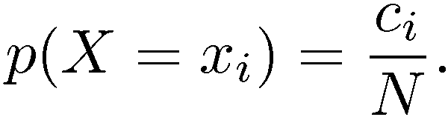
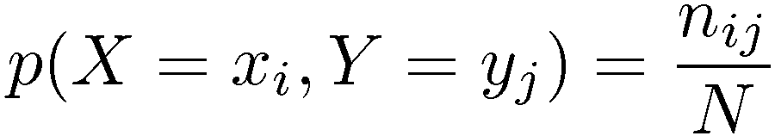
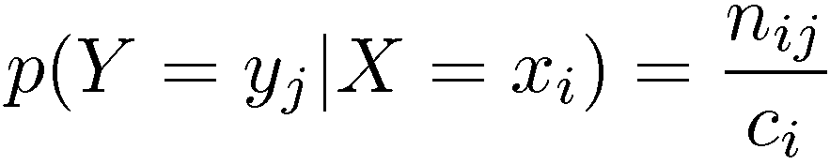
Probability Theory
Marginal Probability
Conditional Probability
Joint Probability

Slide 4
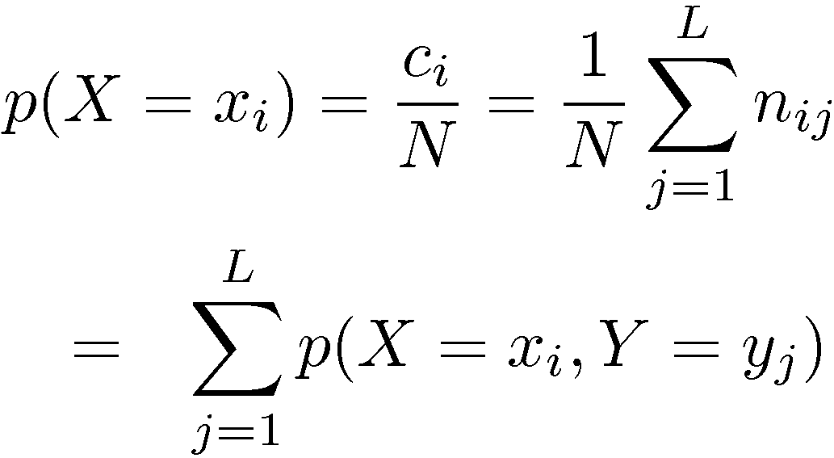
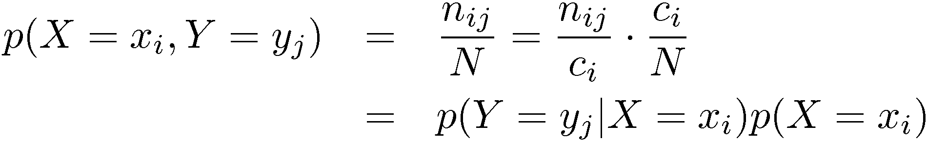
Probability Theory
Sum Rule
Product Rule

Slide 5
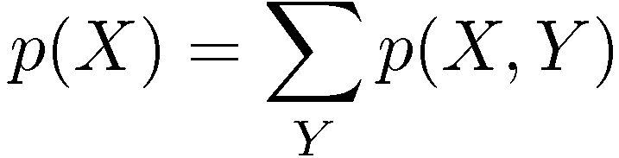

The Rules of Probability
Sum Rule
Product Rule

Slide 6
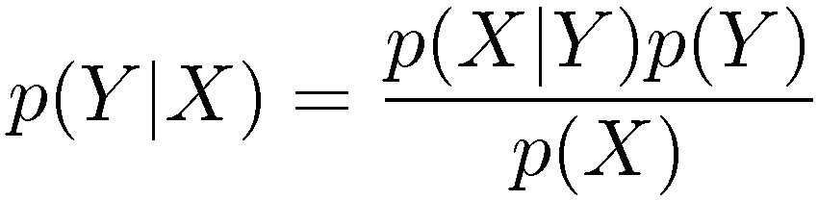
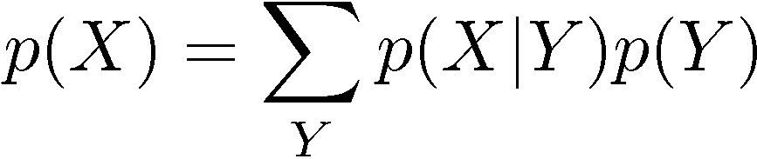
Bayes’ Theorem
posterior ∝ likelihood × prior

Slide 7
1.5 Decision Theory
Determination of p(x, t) from a set of training data is an example of inference and is typically a very difficult problem whose solution forms the subject of much of this book.
In a practical application, we often make a specific prediction for the value of t, or more generally take a specific action based on our understanding of the values t is likely to take, and this aspect is the subject of decision theory.

Slide 8


Decision Theory
Inference step
Determine either or .
Decision step
For given x, determine optimal t.

Slide 9
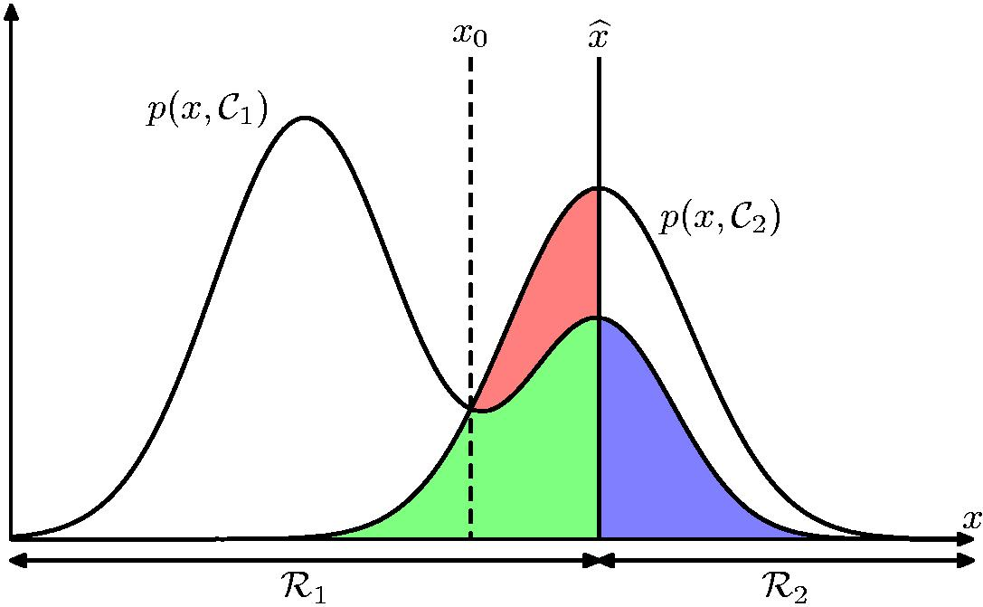
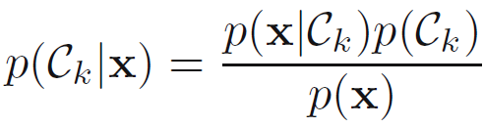
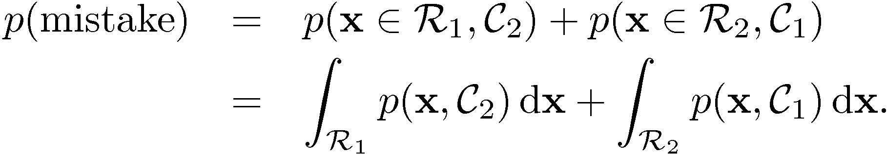
Minimum Misclassification Rate
If our aim is to minimize the chance of assigning x to the wrong class, then intuitively we would choose the class having the higher posterior probability.
decision regions

Slide 10
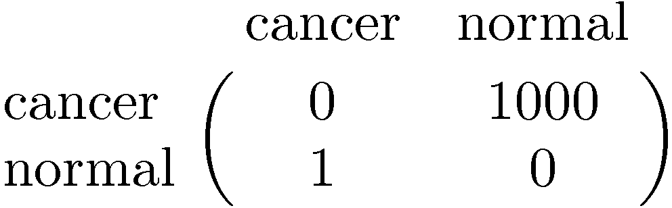
Minimum Expected Loss
Example: classify medical images as ‘cancer’ or ‘normal’
Decision
Truth
loss function / cost function

Slide 11
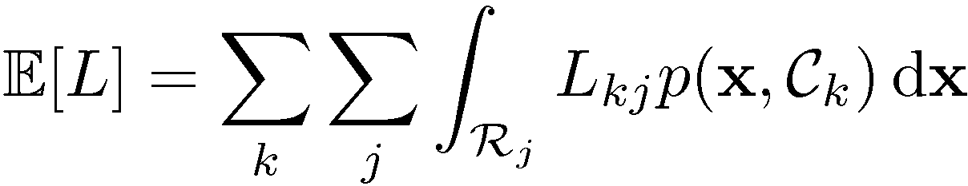

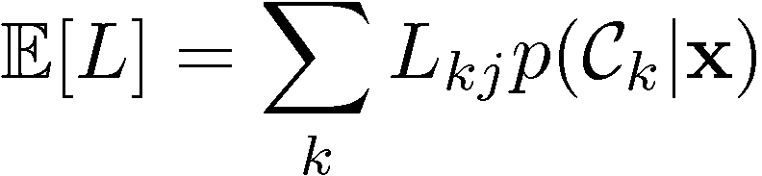
Minimum Expected Loss
Regions are chosen to minimize

Slide 12
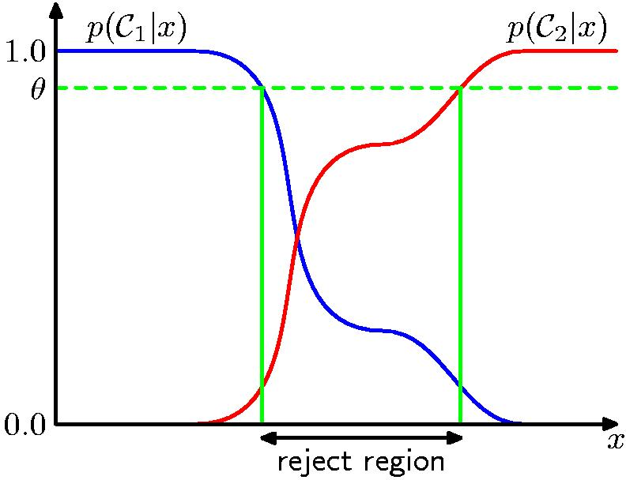
Reject Option

Slide 13
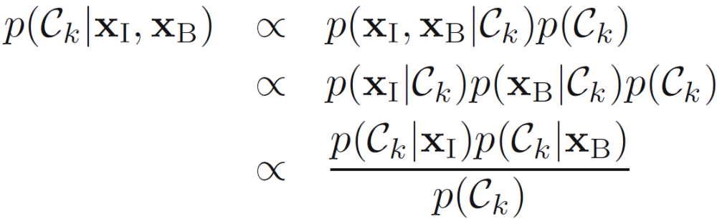
Why Separate Inference and Decision?
Minimizing risk (loss matrix may change over time)
Reject option
Unbalanced class priors
Combining models

Slide 14

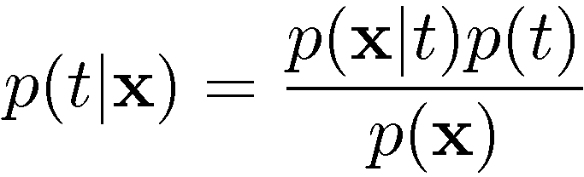
Generative vs Discriminative
Generative approach:
Model
Use Bayes’ theorem
Discriminative approach:
Model directly
Discriminant function

Slide 15
1.6 Information Theory
Information theory will also prove useful in our development of pattern recognition and machine learning techniques
Considering a discrete random variable x, how much information is received when we observe a specific value for this variable. The amount of information can be viewed as the ‘degree of surprise’ on learning the value of x.

Slide 16
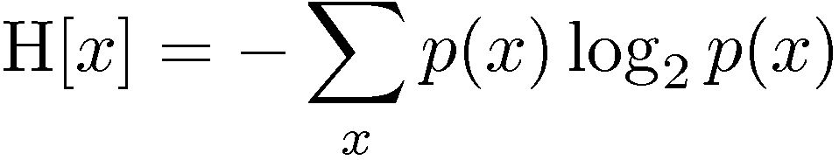
Entropy
Important quantity in
  coding theory
  statistical physics
  machine learning

Slide 17
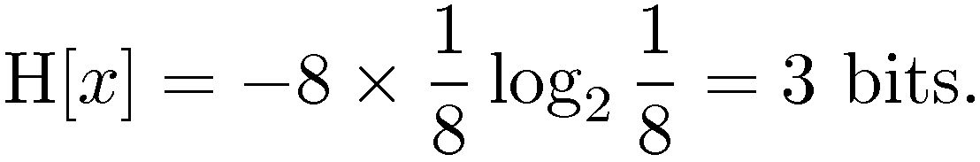
Entropy
Coding theory: x discrete with 8 possible states; how many bits to transmit the state of x?
All states equally likely

Slide 18
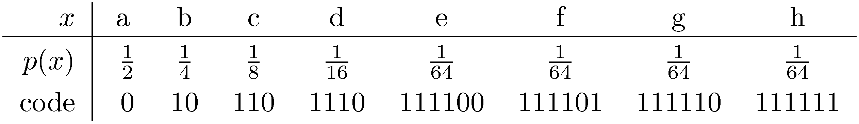
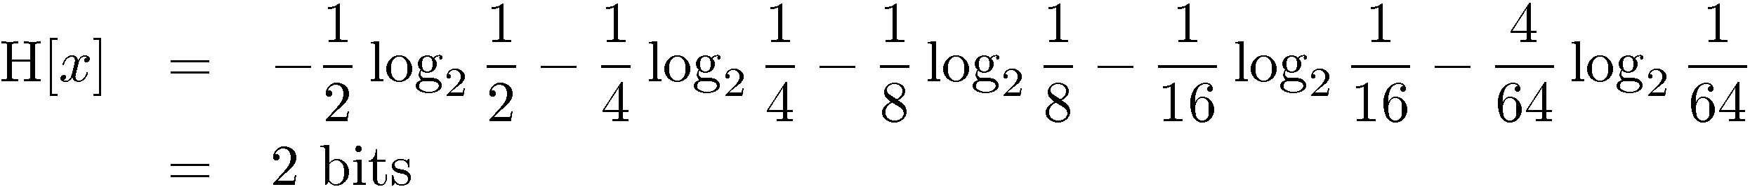
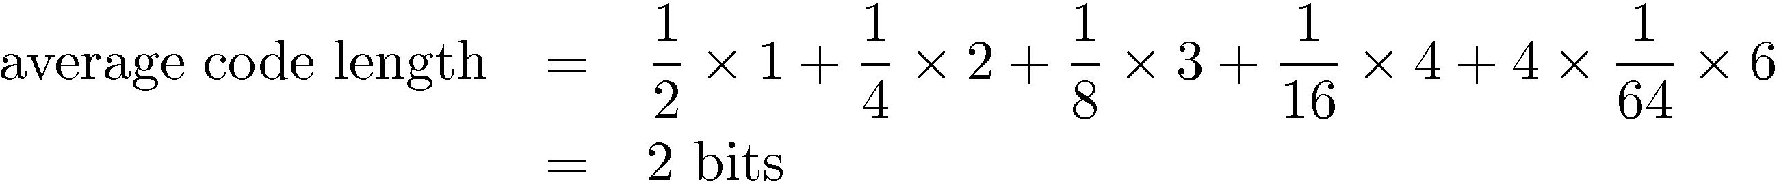
Entropy

Slide 19
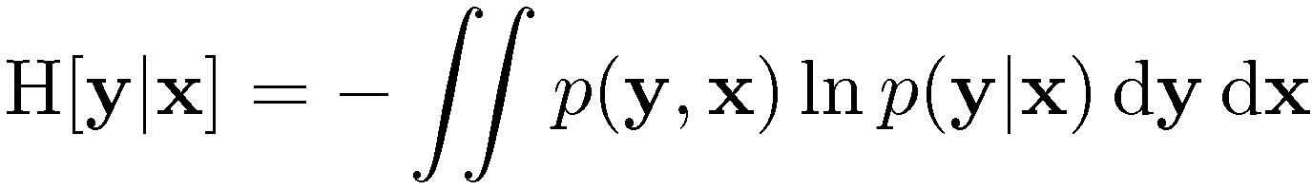

Conditional Entropy

Slide 20
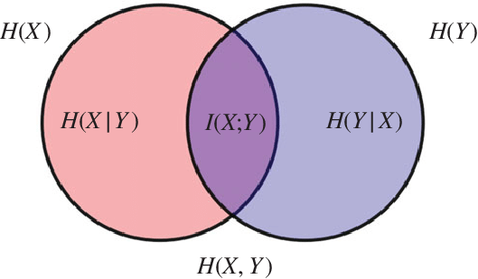
Entropy Venn Diagram

Slide 21
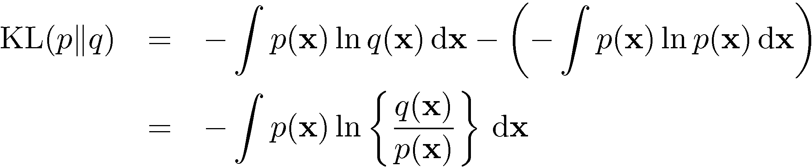
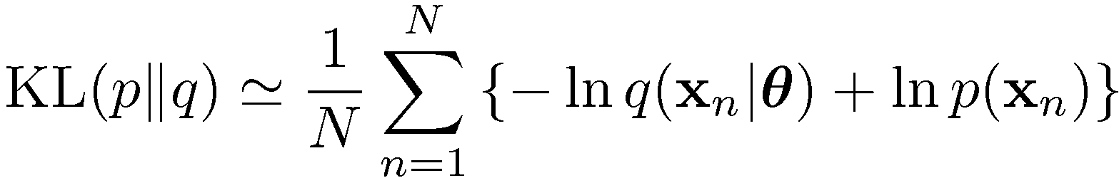


The Kullback-Leibler Divergence

Slide 22
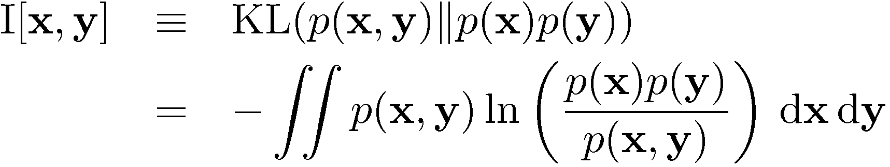
Mutual Information

